Slide 1
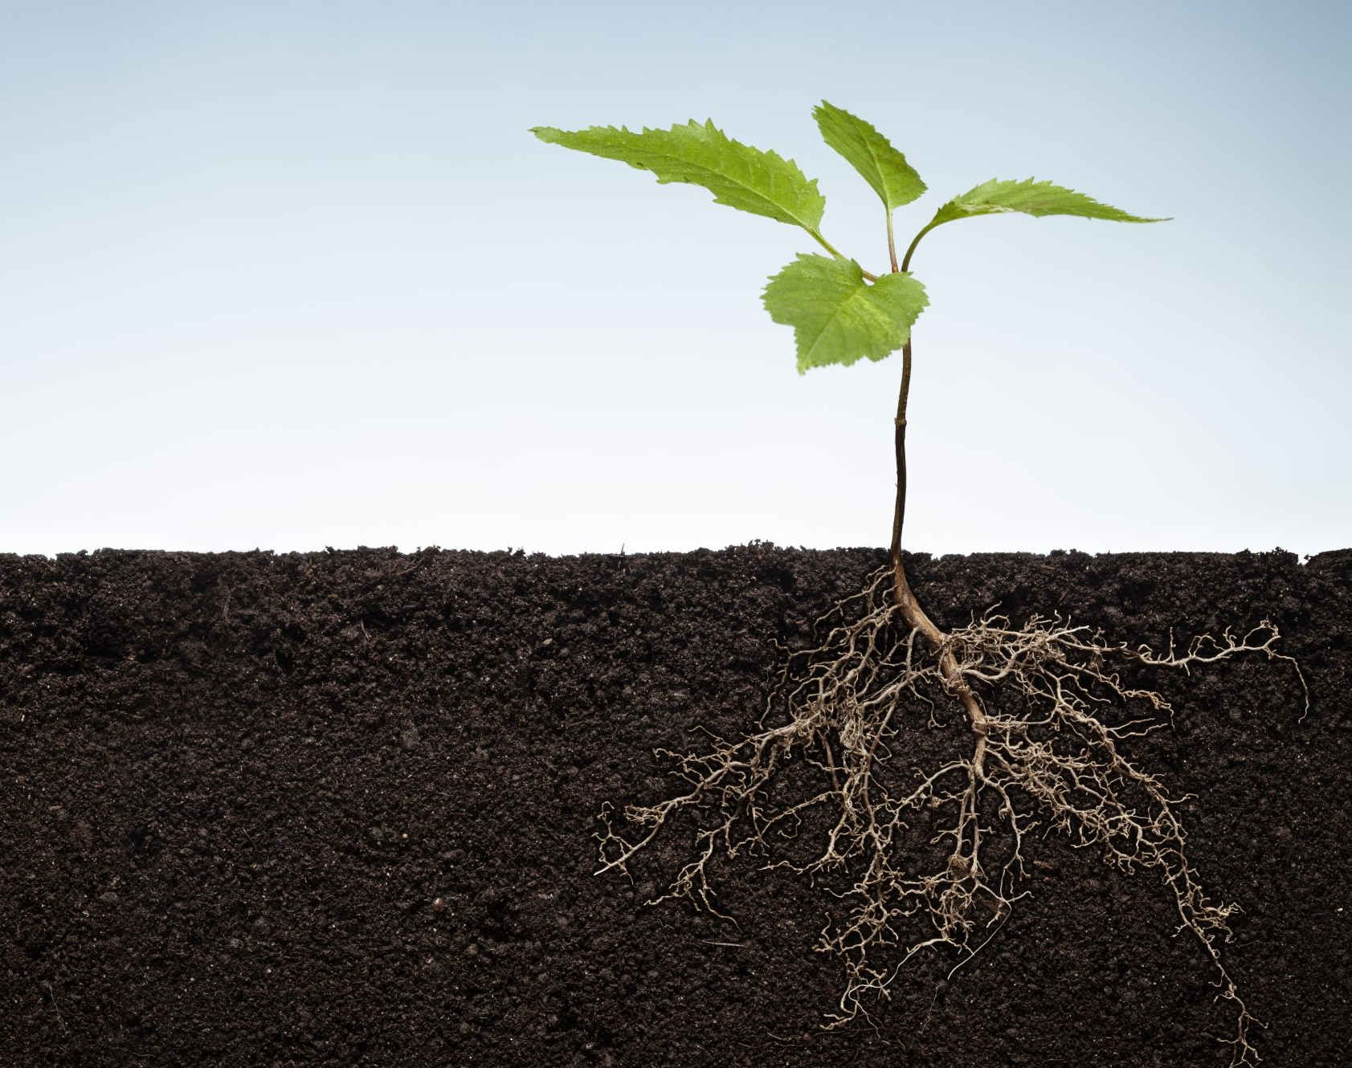

2022 POSTER CONTEST Healthy Soil: Healthy Life
NACD and NACD Auxiliary Soil Info, Rules,
Poster Ideas and Tips

Slide 2

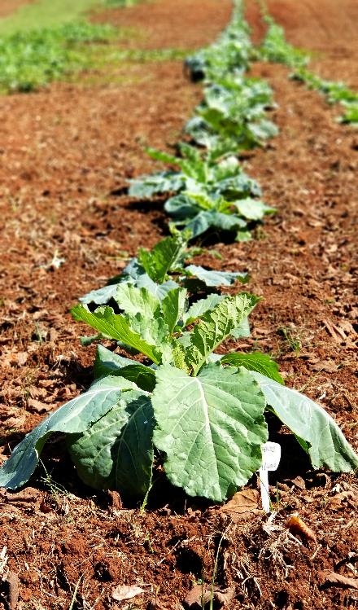

What is Soil Health?
According to United States Department of Agriculture (USDA) Natural Resources Conservation Service (NRCS), soil health, also referred to as soil quality, is defined as the continued capacity of soil to function as a vital living ecosystem that sustains plants, animals and humans.

Slide 3
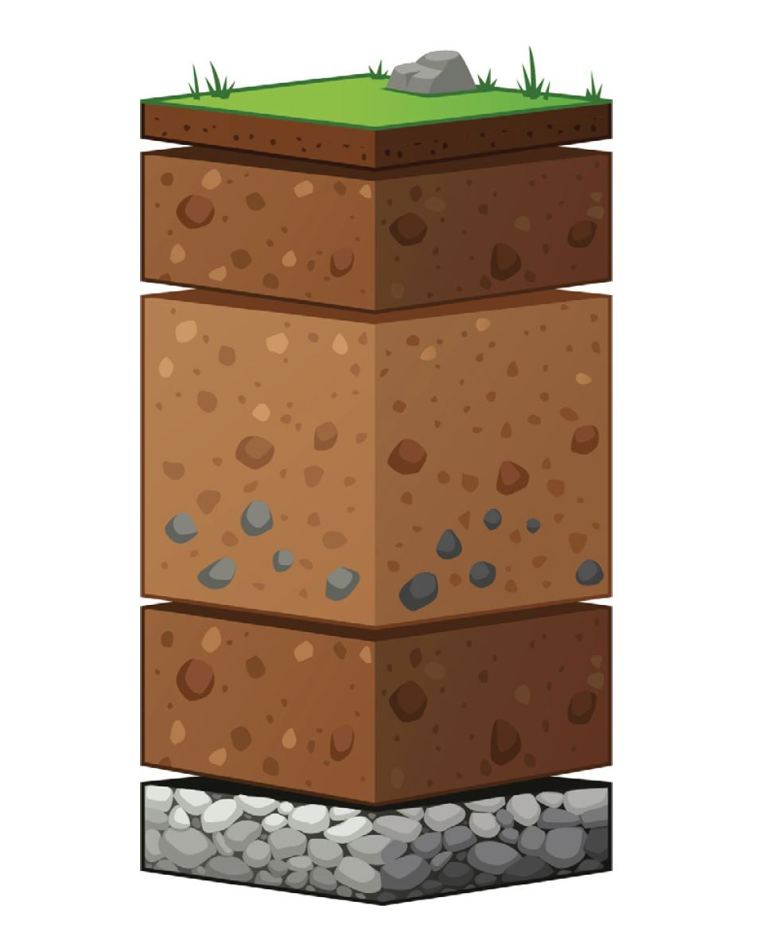
What is soil made up of?
Soil is more than just one layer. It has multiple layers, just like a cake, that are called horizons.
The 0 Horizon is a thin top layer of organic material like decomposing plant materials or the remains of animals and feces.
The A horizon is commonly referred to as topsoil. It is usually dark brown in color and rich in nutrients.
The B horizon is often referred to as subsoil. It contains minerals or organic matter that have been carried down from upper horizons by water.
The C horizon is the parent material of the soil composed of broken up bedrock or sediments.
The R layer is the unweathered parent material of the soil.

Slide 4
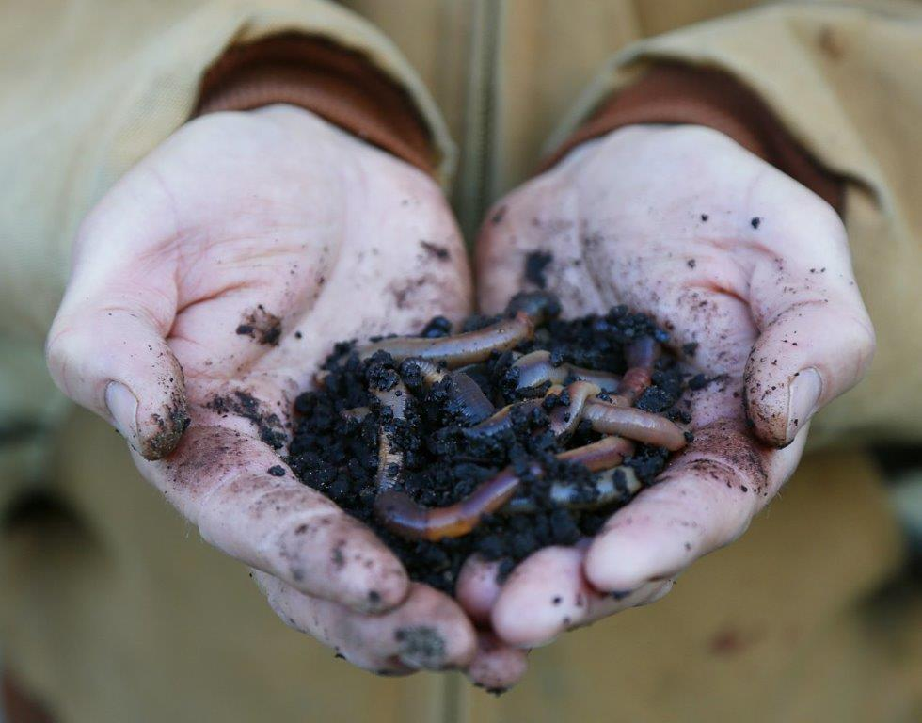
Soils are Habitats!
Soil provides a habitat for animals. Lots of bugs, worms and other critters live in the soil. Some are so small you need a hand lens to see them. Earthworms living in your yard, garden or farm field are a real good sign that you have healthy soil. They make holes that help water and air get deep into the soil that makes it easier for roots and plants to grow.

Slide 5
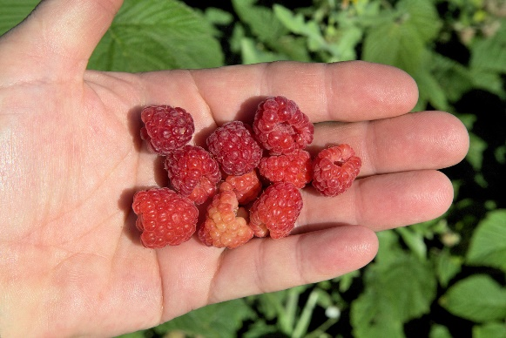
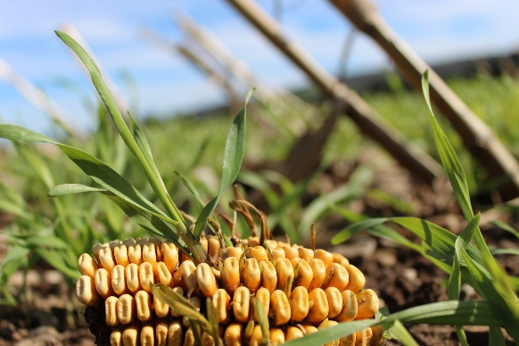
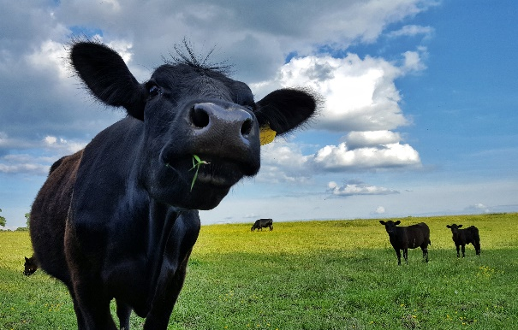
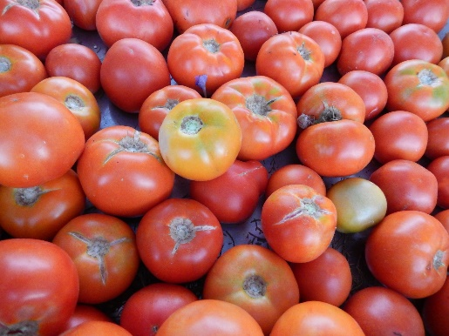
How does healthy soil help us have a healthy life?
The food we eat comes from plants and trees that grow in soil. Farmers and ranchers take good care of the soil on their land. Then, healthy soil grows the healthy food we need to have a healthy life.

Slide 6
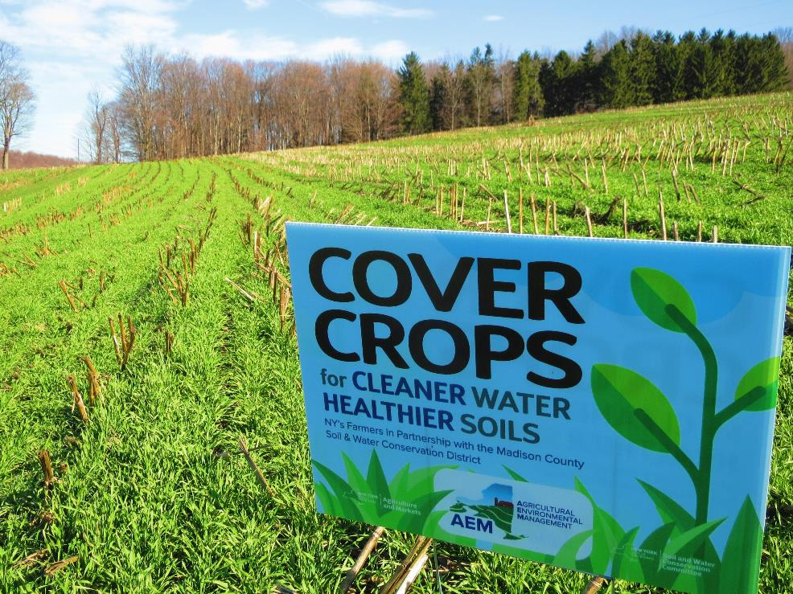
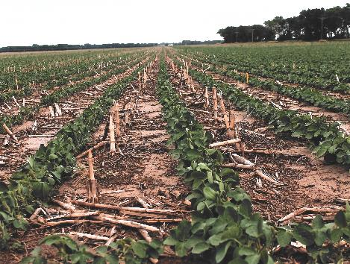
How Do Farmers Help Soils?
Planting cover crops. Cover crops are plants that can protect and put nutrients back into the soil, they aren’t grown for food.
Rotating crops. This is when farmers plant different crops on the same patch of land at different times of the year. This keeps soil healthy by ensuring that soils stay nutrient rich, since not all the same nutrients are being used with each crop.
Keeping soil intact. Tilling is a process that breaks up the soil to make it easier for crops to grow. But, breaking up soils means that they may be washed away by rain or blown away by the wind. Keeping soil intact by having no-till fields keeps soils in place and keeps moisture in the soil.
Using buffer zones. A buffer zone is an area of vegetation between fields that are used to grow crops. Sometimes they are also near streams and lakes. These green spaces can keep soils in place and out of bodies of water.

Slide 7
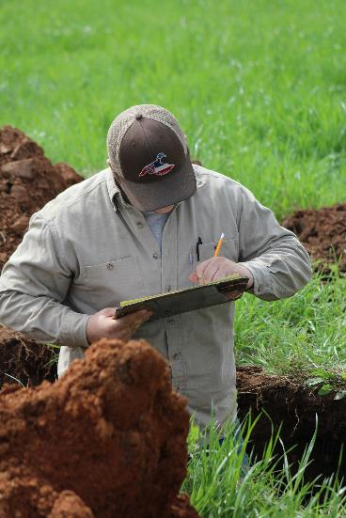
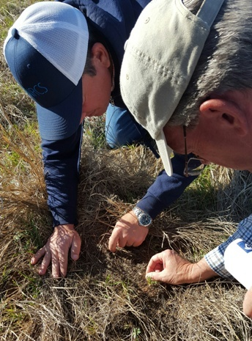
You Can Also Help Soil by Becoming a Soil Scientist!
If you like science, being outside and exploring the environment, becoming a soil scientist might be the career for you!

Slide 8
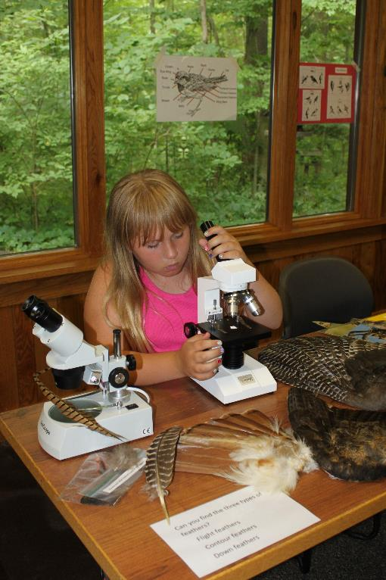
What is Soil Science?
Soil science is the study of soils as a natural resource. This includes understanding soil formation, classification, and mapping; learning about the unique properties of soil including their physical, chemical and biological properties and how fertile they are; and understanding how soil can be managed based on these characteristics.

Slide 9
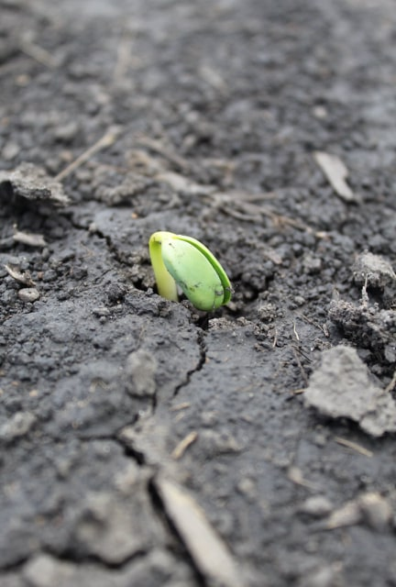
Take Care of Your Soil!
Only about 10% of Earth’s land surface has suitable soil for producing our food supply, housing, cities, schools, hospitals, air to breath and more! Our healthy life above ground depends upon healthy soil below our feet! It is vital that we practice good soil conservation.

Slide 10
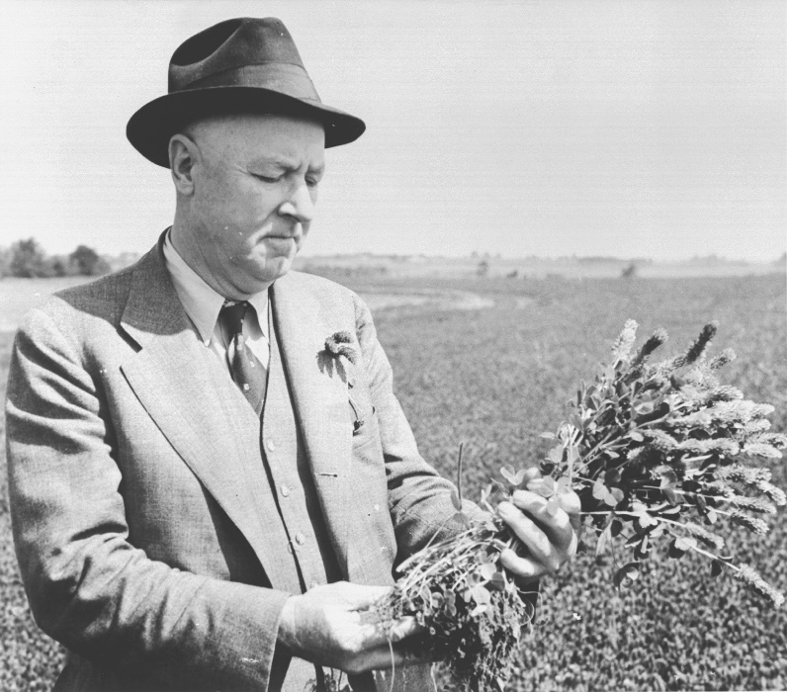
Help is Here!
“Out of the long list of nature’s gifts to man, none is perhaps so utterly essential to human life as soil.” – Hugh Hammond Bennett
Your local conservation district is eager to help you care for your soil. Contact them for information.
National Association of Conservation Districts (NACD) http://www.nacdnet.org/general-resources/conservation-district-directory/
Notes:
Your local conservation district is eager to help you care for your soil. Contact them for information.
National Association of Conservation Districts (NACD) http://www.nacdnet.org/general-resources/conservation-district-directory/
Download the PowerPoint to your computer and add your contact information and some additional slides of projects in your community.

Slide 11

2022 Hand Drawn Poster Contest
Healthy Soil: Healthy Life
The Poster Contest is open to all public, private and homeschooled students in grades K—12.
Contest Categories
K-1st Grade 2nd-3rd Grade 4th-6th Grade 7th-9th Grade 10th-12th Grade
Send entries to your local conservation district:
http://www.nacdnet.org/general-resources/conservation-district-directory/
Contact your conservation district to find out the dates of your local contest!
Notes:
2021 Categories
Grades K-1
Grades 2-3
Grades 4-6
Grades 7-9
Grades 10-12
Some local and state contests have additional categories
Please note, only posters that go through state contests are eligible for the national contest. Do not send posters directly to the national contest.

Slide 12
Poster Contest Details
Winning entries will be selected by your local district and sent to the state level for judging.
State winner entries will then be sent to the national level, where one overall winner will be selected and announced at the 2022 NACD Annual Meeting in Florida, Orlando. Winners will be posted to the NACD website.
Monetary prizes will be awarded to the 1st - 3rd place winners in each category at the national level.
$200 for 1st Place Winners
$150 for 2nd Place Winners
$100 for 3rd Place Winners
Monetary awards from the NACD Auxiliary.

Slide 13
Poster Contest Rules
Poster must be turned in on time for judging.
Attach the poster entry form, signed by a parent or guardian, to the back of the poster.
Entry must be contestant's original creation.
Any media may be used to create a flat poster (ex. paint, crayons, stickers, etc.)
The 2022 Stewardship theme “Healthy Soil: Healthy Life” must be included on the front side of each poster submission to be eligible for the national poster contest.

Slide 14
Poster Contest Rules Cont.
Traditional painted or drawn posters should be photographed or scanned and submitted as a JPG or PDF.
Photographs must be clear and well framed.
It is the local district/state association/auxiliary/agency’s decision what size and what kind of poster (paper copy or photographed) they accept for your local or state contest.
Only official state poster contest sponsors can submit entries for the national contest. Entries must be submitted by December 1, 2022, and emailed to stewardship@nacdnet.org.

Slide 15

2022 Digital Poster Contest Healthy Soil: Healthy Life
NACD will also be accepting digital posters in two categories: 7-9 grade and 10-12 grade from public, private and homeschooled students.
Artwork entered into the national competition must have been judged in a local or area conservation district sponsored poster contest and a state/territory conservation association or state auxiliary sponsored contest.
Monetary prizes will be awarded to the 1st - 3rd place winners in each category at the national level.
$200 for 1st Place Winners
$150 for 2nd Place Winners
$100 for 3rd Place Winners

Slide 16
Digital Poster Contest Rules
The posters must be a digital design and can be created in any platform used for digital projects such as Canva, PicMonkey, Google Slides, Photoshop, InDesign, etc.
The poster design should be size 8.5 X 11 landscape or portrait and at least 300DPI.
Digital posters must be original art and shall not include any copyrighted, trademarked or branded marks, images or phrases besides the NACD 2022 themed logo.
Digital posters should be submitted in JPEG or PNG format.
The 2022 Stewardship theme “Healthy Soil: Healthy Life” must be included in each poster submission to be eligible for the national poster contest.
Each entry for the national contest must be submitted to NACD with an entry form to be eligible for judging. The form must be completed and signed by a parent or guardian, scanned and emailed to NACD.
Only official state poster contest sponsors can submit entries for the national contest. Entries must be submitted by December 1, 2022, and emailed to stewardship@nacdnet.org.

Slide 17
What makes a good Poster?
Attracts attention
Is simple and concise
Uses colors and white space effectively
Text is large enough to be easily read
Notes:
What makes a good poster?
Attracts attention
Is simple and clear
Uses colors and white space to get and hold attention
Letters are large enough to be easily read

Slide 18
When forming ideas for your poster…
Research the topic of the theme
Brainstorm ideas and make a list
Use the theme as your title:
“Healthy Soil: Healthy Life”
Use some of the important issues from this presentation
Look around your community for ideas
Talk to professionals in the industry
Research soil health and use the information you find
Notes:
Research the topic of the theme
Brainstorm ideas and make a list
Think of the theme and use the theme as your title

Slide 19
Poster TIPS
Do…
limit text and balance a combination of illustrations and words.
be as neat as you can and be sure to erase any penciled sketches or guidelines.
blend colors when using crayons or colored pencils.
research the theme topic as a way to brainstorm poster ideas.

Slide 20
Poster TIPS Cont.
Don’t…
use staples, tacks or tape.
use fluorescent-colored posters.
create a poster that is all words or all illustrations.
have your parent or others draw your poster for you to color in.
try to include too many ideas. A single message – clearly illustrated – is most effective.

Slide 21
Judging
Judging Criteria | Weight
Conservation Message | 50%
Visual Effectiveness | 30%
Originality | 10%
Universal Appeal | 10%

Slide 22
For Additional Information…
Visit https://www.nacdnet.org/conservation-education-hub/
Entry Forms, Rules and Resource files are also available for download on the contest page at:
https://www.nacdnet.org/general-resources/stewardship-and-education-materials/contests/

Slide 23

Submissions must be made to MCCD by May 27, 2022
Posters can be submitted via email to areiter@montgomeryconservation.org
Notes:
Local info – contest dates – contact info

